Slide 1
به نام خدا
Exploring Direct Memory Access
محمد مهدی نعمتی هروانی استاد: حامد فربه

Slide 2
Introduction
What is DMA?
DMA stands for Direct Memory Access. It is a feature or mechanism in computer systems that allows certain hardware devices, I/O devices, to transfer data directly to and from the system's memory without involving the main processor (CPU).
Traditionally, when a hardware device needs to read from or write to memory, it would have to go through the CPU. The CPU would handle the data transfer, which could result in increased CPU usage and slower overall system performance.
With DMA, the hardware device can bypass the CPU and directly access the system memory. The DMA controller, a dedicated hardware component, manages the data transfer between the hardware device and memory. It coordinates the movement of data by temporarily taking control of the system bus and transferring data in blocks or bursts, freeing up the CPU to perform other tasks.

Slide 3
Introduction
What is DMA-Controller?
DMA Controller is a hardware device that allows I/O devices to directly access memory with less participation of the processor.
Direct Memory Access uses hardware for accessing the memory, that hardware is called a DMA Controller. It has the work of transferring the data between Input Output devices and main memory with very less interaction with the processor. The direct Memory Access Controller is a control unit, which has the work of transferring data.
DMA Controller is a type of control unit that works as an interface for the data bus and the I/O Devices. As mentioned, DMA Controller has the work of transferring the data without the intervention of the processors, processors can control the data transfer. DMA Controller also contains an address unit, which generates the address and selects an I/O device for the transfer of data. Here we are showing the block diagram of the DMA Controller.

Slide 4
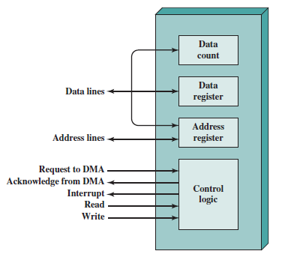
DMA Controller Diagram

Slide 5
Types of Direct Memory Access
Single-Ended DMA: Single-Ended DMA Controllers operate by reading and writing from a single memory address. They are the simplest DMA.
Dual-Ended DMA: Dual-Ended DMA controllers can read and write from two memory addresses. Dual-ended DMA is more advanced than single-ended DMA.
Arbitrated-Ended DMA: Arbitrated-Ended DMA works by reading and writing to several memory addresses. It is more advanced than Dual-Ended DMA.
Interleaved DMA: Interleaved DMA are those DMA that read from one memory address and write from another memory address.

Slide 6
Working of DMA Controller
The DMA controller registers have three registers as follows.
Address register – It contains the address to specify the desired location in memory.
Word count register – It contains the number of words to be transferred.
Control register – It specifies the transfer mode.
Note: All registers in the DMA appear to the CPU as I/O interface registers. Therefore, the CPU can both read and write into the DMA registers under program control via the data bus.
Explanation: The CPU initializes the DMA by sending the given information through the data bus.
The starting address of the memory block where the data is available (to read) or where data are to be stored (to write).
It also sends word count which is the number of words in the memory block to be read or written.
Control to define the mode of transfer such as read or write.
A control to begin the DMA transfer

Slide 7
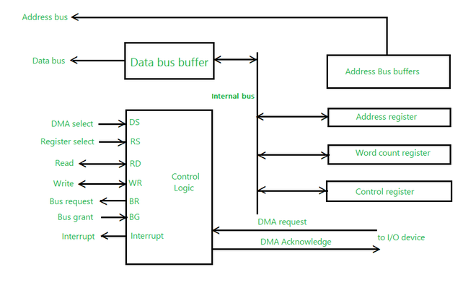
Working Diagram of DMA Controller

Slide 8
Modes of Data Transfer in DMA
There are 3 modes of data transfer in DMA that are described below.
Burst Mode: In Burst Mode, buses are handed over to the CPU by the DMA if the whole data is completely transferred, not before that.
Cycle Stealing Mode: In Cycle Stealing Mode, buses are handed over to the CPU by the DMA after the transfer of each byte. Continuous request for bus control is generated by this Data Transfer Mode. It works more easily for higher-priority tasks.
Transparent Mode: Transparent Mode in DMA does not require any bus in the transfer of the data as it works when the CPU is executing the transaction. In Transparent Mode, the DMA controller takes advantage of idle bus cycles or wait states during the CPU's execution to perform data transfers

Slide 9
Cons and Pros
Advantages of DMA Controller
Data Memory Access speeds up memory operations and data transfer.
CPU is not involved while transferring data.
DMA requires very few clock cycles while transferring data.
DMA distributes workload very appropriately.
DMA helps the CPU in decreasing its load.
Disadvantages of DMA Controller
Direct Memory Access is a costly operation because of additional operations.
DMA suffers from Cache-Coherence Problems.
DMA Controller increases the overall cost of the system.
DMA Controller increases the complexity of the software.

Slide 10
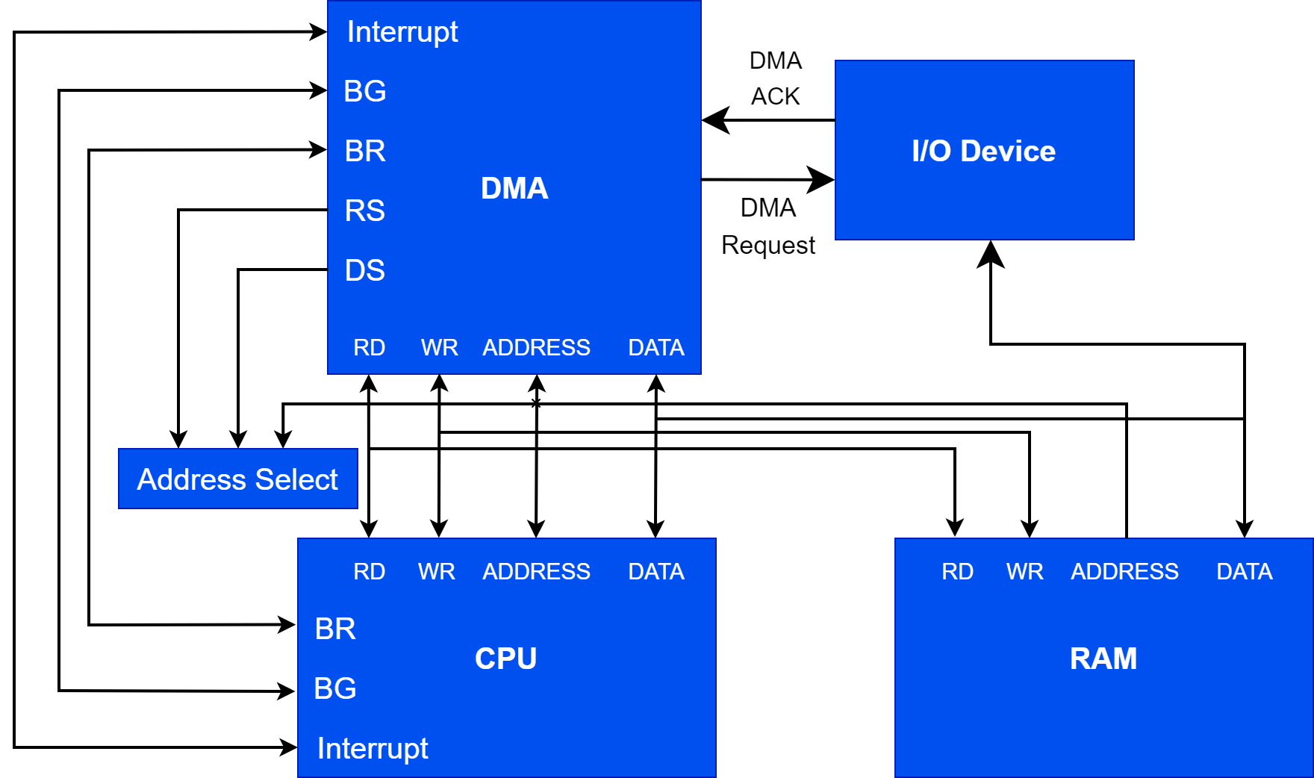

Slide 11
DMA policies
Priority-Based Scheduling
Round-Robin Scheduling
Cache Coherency Policies
Error Handling and Retry Policies
Bus Arbitration Policies

Slide 12
thanks for your attention

